Slide 1
Exam prep game

Slide 2
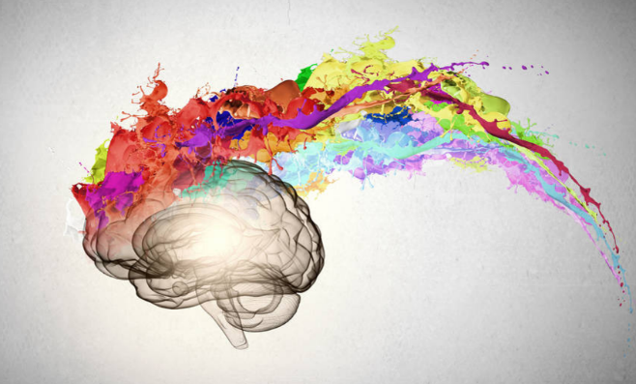
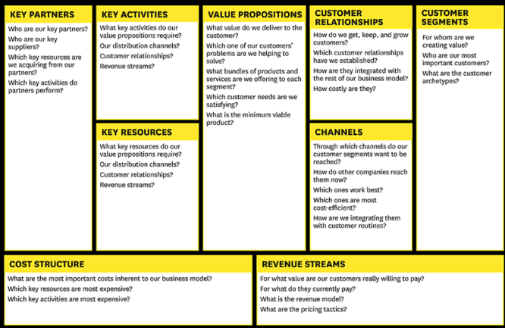


What insights from the business analysis did you use in the design? How did they influence the result?
What did you consider the most important insight from the BMC? How did you use it?
Pic source: http://www.hec.edu/Knowledge/Marketing/Marketing-Strategy/How-can-you-harness-insight-a-powerful-tool-for-innovation
Hvad fandt du var den vigtigste indsigt fra BMC? Hvordan brugte I den viden?
Pic source: https://www.google.dk/url?sa=i&rct=j&q=&esrc=s&source=images&cd=&ved=0ahUKEwjxxf6AopjXAhUQPVAKHaC1DPwQjhwIBQ&url=https%3A%2F%2Fwww.probizservices.com%2Fthe-business-model-canvas-a-tool-for-success%2F&psig=AOvVaw2A1IrV3TJsVOxj2W154PAq&ust=1509450108266451
Hvilke indsigter fra forretningsanalysen brugte du i designet? Hvordan påvirker de resultatet?
What was difficult in translating your design into code? Why?
How did you create your personas? How did you go from data to an actual persona?
Hvad var svært ved at oversætte jeres design til kode? Hvorfor?
Hvordan har I skabt jeres personas? Hvordan gik I fra data til en faktisk persona?
Pic source: http://www.teq.com/teq-news/lost-translation-check-improved-google-translate/
Pic source: https://www.optimizeroi.com/en/what-is-a-persona-and-how-to-create-one/

Slide 3




How can we see your persona(s) in your design? Give concrete examples.
How can we see your persona(s) in your functionalities? Give concrete examples.
Hvordan kan vi se din persona(er) i jeres design? Giv konkrete eksempler.
Hvordan kan vi se din persona(er) i jeres funktionaliteter? Giv konkrete eksempler.
Pic source: https://seopressor.com/blog/how-to-create-buyer-persona/
Pic source: https://dk.linkedin.com/pulse/den-store-guide-til-udvikling-af-personas-uffe-lyngaae
How did you build your HTML - based on what?
Beskriv sammenhængen mellem Tone of Voice og content
Pic source: https://www.edelman.com/insights/intellectual-property/employee-engagement-connections-index/
Hvordan byggede I jeres HTML - baseret på hvad?
Pic source: https://www.udemy.com/build-website-scratch/

Slide 4
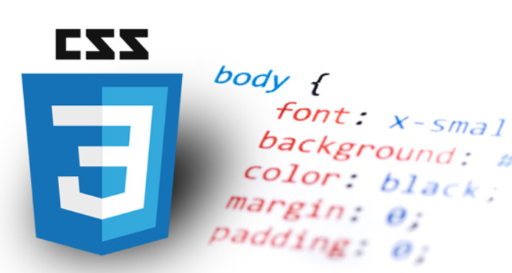


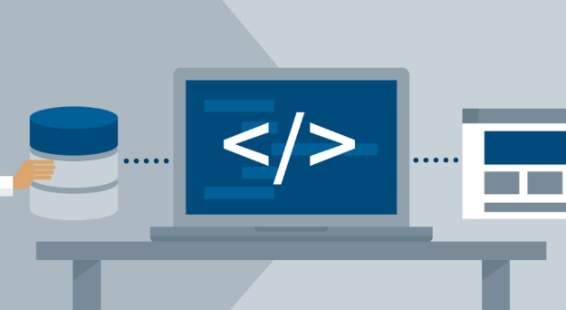
How did you build your CSS - based on what?
How did you build your Javascript - based on what?
Hvordan byggede I jeres CSS - baseret på hvad?
Pic source: https://learning.linkedin.com/blog/tech-tips/5-great-reasons-to-learn-a-little-css
Hvordan byggede I jeres Javascript - baseret på hvad?
Which design solutions did you make to fulfill user needs?
What problems occurred while coding?
How did you solve them?
Hvilke designløsninger har I lavet for at imødekomme user needs?
Pic source: https://experience.sap.com/basics/design-ux-ui-difference/

Slide 5

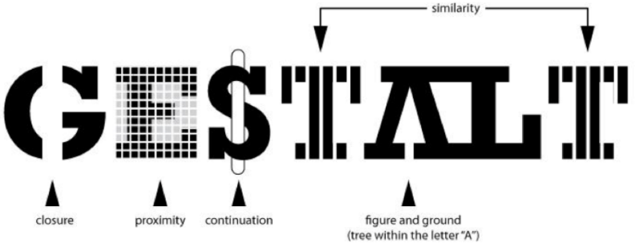


How did you use the gestalt laws? What is the purpose of the gestalt laws
Which design solutions did you make to fulfill business goals?
Pic source http://www.wecooperate.net/setting-business-goals
Hvilke designløsninger har I lavet for at imødekomme business goals
Hvordan har I brugt gestalt lovene? Og hvad er formålet med dem?
Pic source http://www.howdesign.com/design-business/design-thinking/gestalt-principles-for-information-design/
How did you use hierarchy, white space, use of contrast? What is the purpose of this?
How did you work with navigation? Is it good navigation?
Pic source: https://www.istockphoto.com/dk/photos/empty-white-space?excludenudity=false&sort=mostpopular&mediatype=photography&phrase=empty%20white%20space
Hvordan bruger I hierarki, brug af kontrast, whitespace osv
Pic source: https://blog.commlabindia.com/elearning-design/elearning-design-course-navigation-infographic
Hvad er formålet med hierarki, brug af kontrast, whitespace osv.?
How did you work with navigation? Hvad skal en god navigation indeholde?

Slide 6
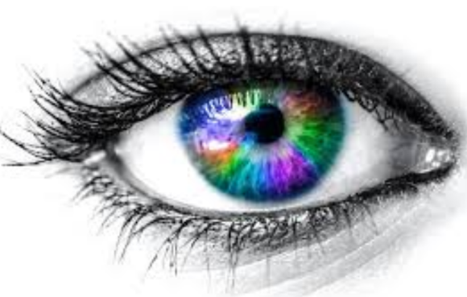



How are your messages being communicated visually?
How did you ”get to know” the target audience?
Pic Source: http://anguerde.com/TTF-395042-visual.html
Pic Source: https://curatti.com/target-audience/
Hvordan bliver jeres budskaber visuelt formidlet?
Hvordan har I ”lært målgruppen at kende”?
Which visual perception, user experience, do you want the user to have, and how can we see this?
How did you test your solution? At which stages?
Pic source: http://sathitamai.wixsite.com/visualartseportfolio/single-post/2015/11/16/Gestalt-theory
Pic source: https://usabilitygeek.com/usability-testing-prototypes/
Hvilken visuel perception, user experience, vil I gerne have at brugeren får og hvordan kan vi se dette?
Hvordan testede I jeres løsning? På hvilke stadier?

Slide 7


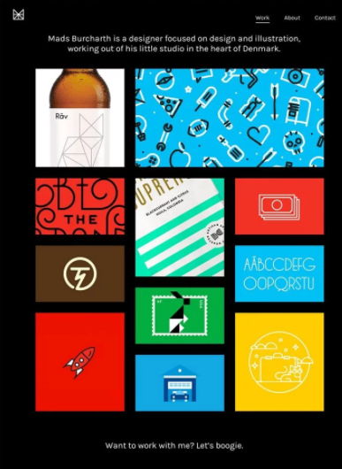

Hvordan kan jeg se jeres persona i jeres content?
Har I gjort jer nogle SEO overvejelser i løsningen? Hvilke/ hvordan?
https://negosentro.com/the-benefits-of-combining-content-marketing-and-segmentation/
Pic: https://optinmonster.com/ultimate-seo-guide/
Hvilke overvejelser har I gjort jer om indholdet ift kunden?
Har I gjort jer overvejelser omkring jeres content i designet?
Pic https://www.canva.com/learn/minimalist-design-beautiful-examples-and-practical-tips/
Pic: https://seopage1.net/finished-a-content-writing-project/

